Slide 1
Machine learning: Fundamentals and Applications (AAI-510-03)
University of San Diego Prof. Dave Friesen
Aditi Jha & James McCarthy

Slide 2
Contents
Year/Quarter/Month
1.
Add section title
2.
Add section title
3.
Add section title
4.
Add section title
5.
Add section title
6.
Add section title

Slide 3

Predicting Customer Review Ratings with AI
AAI-510: Team 7
Title
Turning Text Reviews into Actionable Insights

Slide 4
Thousands of Reviews, but no time to read them all.
AAI-510
The Problem
Star ratings are useful—but often inconsistent or missing.
Manually reviewing is slow, expensive, and impractical.
Provide a high-level summary of what you’ll be discussing in this presentation.

Slide 5
Can we predict rating from the review itself?
AAI-510
Our Goal
Use AI to read customer reviews and predict the star rating (1 to 5).
Helps monitor satisfaction, detect unhappy customers, and find improvement areas.

Slide 6

University of San Diego
Two Massive Review Platforms
Our Data Sources
Amazon Reviews (Product feedback)
5000 product reviews from the real users.
Dataset has 5000 rows and 12 columns.
Yelp Reviews (Service and business feedback)
More than 100,000 of real reviews from real users.
Dataset has 100,000 rows and 9 columns.
AA1-510: Team 7
Row | reviewerID | asin | reviewerName | helpful | reviewText | overall | summary | unixReviewTime | reviewTime | day_diff | helpful_yes | total_vote
0 | A3SBTW3WS4IQSN | B007WTAJTO | NaN | [0, 0] | No issues. | 4.0 | Four Stars | 1406073600 | 2014-07-23 | 138 | 0 | 0
1 | A18K1ODH1I2MVB | B007WTAJTO | 0mie | [0, 0] | Purchased this for my device, it worked as adv... | 5.0 | MOAR SPACE!!! | 1382659200 | 2013-10-25 | 409 | 0 | 0
2 | A2FII3I2MBMUIA | B007WTAJTO | 1K3 | [0, 0] | it works as expected. I should have sprung for... | 4.0 | nothing to really say.... | 1356220800 | 2012-12-23 | 715 | 0 | 0
3 | A3H99DFEG68SR | B007WTAJTO | 1m2 | [0, 0] | This think has worked out great.Had a diff. br... | 5.0 | Great buy at this price!!! *** UPDATE | 1384992000 | 2013-11-21 | 382 | 0 | 0
4 | A375ZM4U047O79 | B007WTAJTO | 2&amp;1/2Men | [0, 0] | Bought it with Retail Packaging, arrived legit... | 5.0 | best deal around | 1373673600 | 2013-07-13 | 513 | 0 | 0
Row | review_id | user_id | business_id | stars | useful | funny | cool | text | date
0 | KU_O5udG6zpxOg-VcAEodg | mh_-eMZ6K5RLWhZyISBhwA | XQfwVwDr-v0ZS3_CbbE5Xw | 3 | 0 | 0 | 0 | If you decide to eat here, just be aware it is... | 2018-07-07 22:09:11
1 | BiTunyQ73aT9WBnpR9DZGw | OyoGAe7OKpv6SyGZT5g77Q | 7ATYjTIgM3jUlt4UM3IypQ | 5 | 1 | 0 | 1 | I've taken a lot of spin classes over the year... | 2012-01-03 15:28:18
2 | saUsX_uimxRlCVr67Z4Jig | 8g_iMtfSiwikVnbP2etR0A | YjUWPpI6HXG530lwP-fb2A | 3 | 0 | 0 | 0 | Family diner. Had the buffet. Eclectic assortm... | 2014-02-05 20:30:30
3 | AqPFMleE6RsU23_auESxiA | _7bHUi9Uuf5__HHc_Q8guQ | kxX2SOes4o-D3ZQBkiMRfA | 5 | 1 | 0 | 1 | Wow! Yummy, different, delicious. Our favo... | 2015-01-04 00:01:03
4 | Sx8TMOWLNuJBWer-0pcmoA | bcjbaE6dDog4jkNY91ncLQ | e4Vwtrqf-wpJfwesgvdgxQ | 4 | 1 | 0 | 1 | Cute interior and owner (?) gave us tour of up... | 2017-01-14 20:54:15

Slide 7
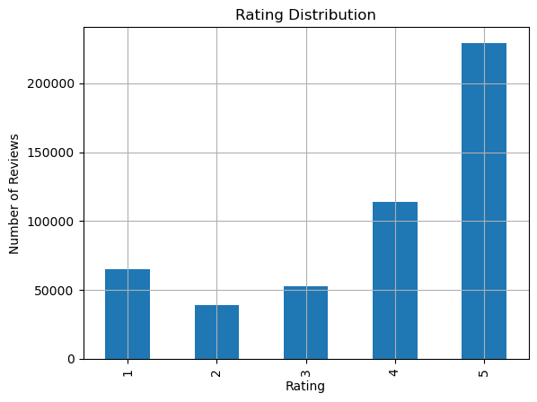
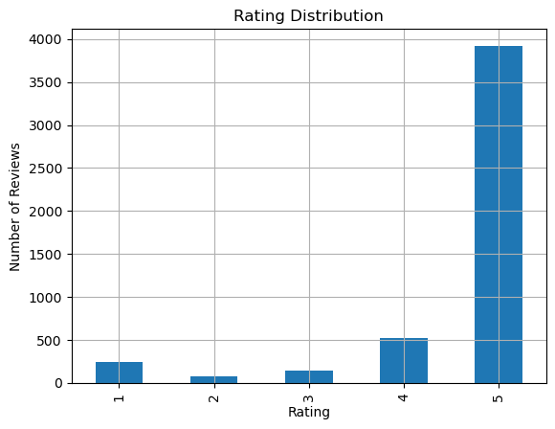
University of San Diego
Rating Distributions
Yelp
Amazon
AA1-510: Team 7

Slide 8
University of San Diego
What We Tried
Simple Word Counts (Bag of Words)
Word Meaning Models(Embeddings)
Advanced AI – BERT
AA1-510: Team 7
We counted how often words appeared in reviews.
Words like “great” or “bad” influenced the prediction.
Easy to use, but doesn’t understand meaning or context.
These models understand relationships between words.
For example, they know that “terrible” is similar to “awful.”
They give the AI a better grasp of tone and sentiment.
Smarter, but still not personalized to our data.
This model reads reviews like a human would.
It understands tone, context, and even subtle language.
For example, it knows “not bad at all” is actually positive.
Most accurate and reliable model for predicting ratings.

Slide 9
Company Name
University of San Diego
How It Works
Learns by Example
Understands Context and Tone
Reads Like a Human
AAI-510: Team 7
We gave the AI thousands of real reviews, each with a known rating.
It read them carefully and started to recognize patterns.
Words like “amazing,” “highly recommend,” “perfect” → usually 5 stars.
Phrases like “never again,” “waste of money,” “terrible” → usually 1 star.
Knows the difference between “good” and “not good.”
Recognizes sarcasm, like: “Just what I needed—another broken charger” Understands how words change meaning depending on how they’re used.
Instead of looking at isolated words, it reads entire sentences.
It captures the emotion, intent, and nuance in the review.
Then, it gives its best prediction of what rating the customer would have chosen.

Slide 10
“It works perfectly, delivery was fast!” ⭐⭐⭐⭐⭐
“I’m really disappointed. Broke after one day.” ⭐
“Okay product, not amazing but not bad either.” ⭐⭐⭐
Review Text AI Prediction Example
AAI-510:Team 7

Slide 11
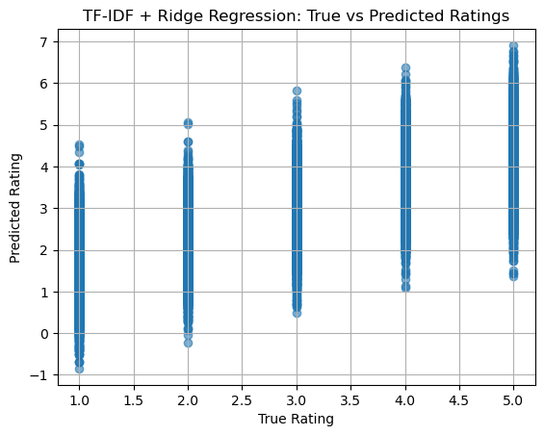
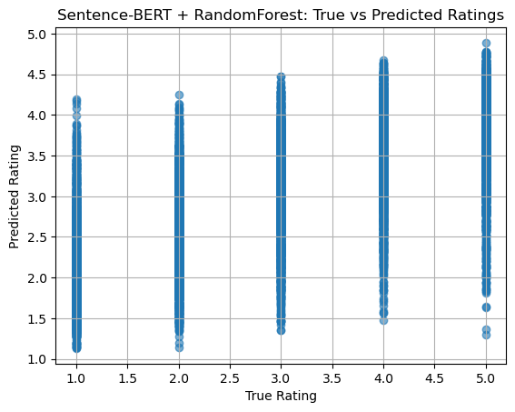
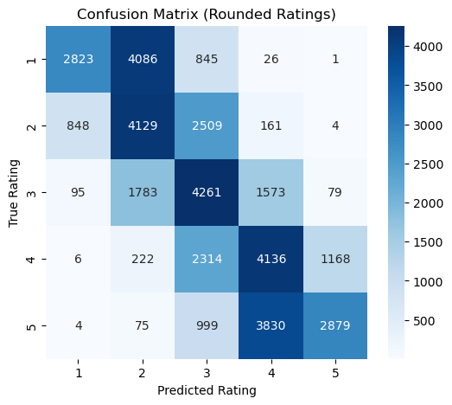
University of San Diego
Model Performance
TF-IDF + Ridge Regression
Sentence-BERT + Random Forest
Confusion Matrix (TF-IDF + R)
AA1-510: Team 7

Slide 12
Real-World Impact

Slide 13
Recommendations

Slide 14
Thank you

